Slide 1
Glass structure of granulated blast furnace
slag and its reactivity – A new approach
Andreas EHRENBERG
(FEhS - Institut für Baustoff-Forschung, Duisburg)
Natalja PRONINA, Hansjörg BORNHÖFT, Joachim DEUBENER
(Clausthal University of Technology, Inst. of Non-Metallic Materials, Clausthal-Zellerfeld)
6th Slag Valorisation Symposium, Mechelen, 01-05 April 2019

Slide 2
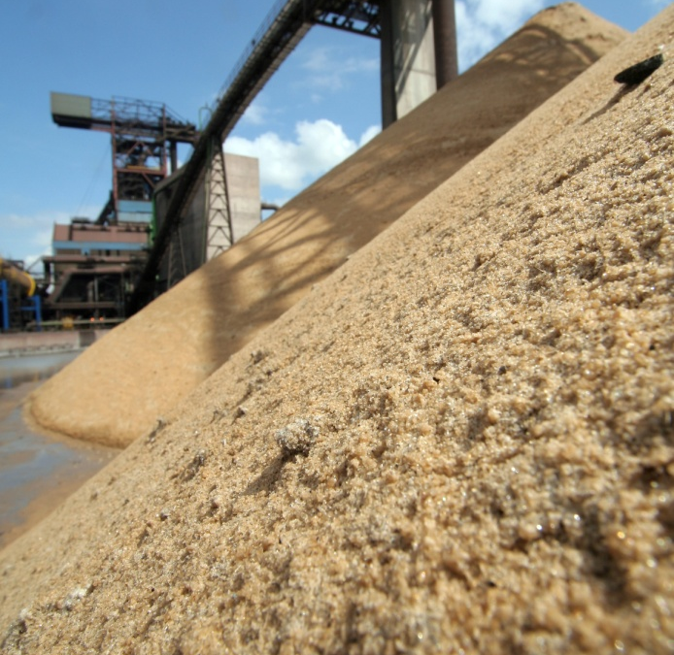
Overview
Background
Basic ideas and questions
Properties of annealed GBS
Properties of GBS fractions
Conclusions

Slide 3
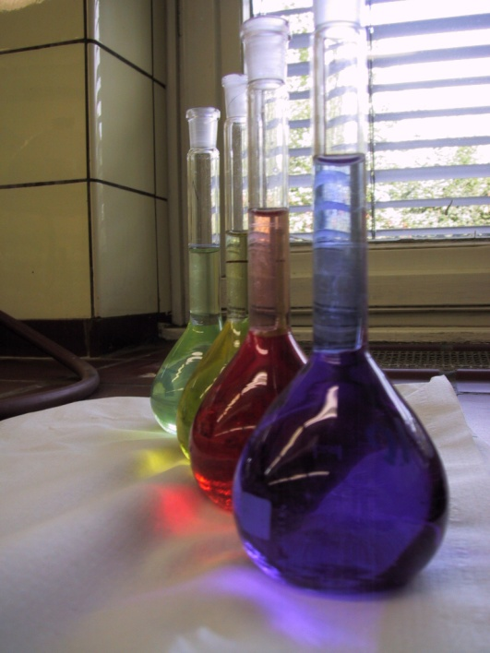
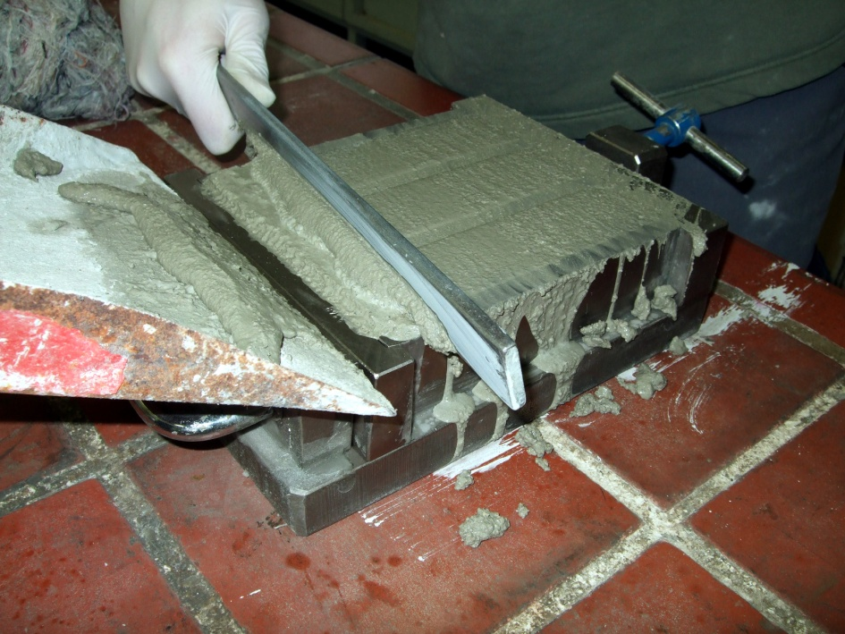
?
Background

Slide 4
Is there any simple correlation of chemical
slag analysis and slag cement reactivity?
typical range of a blast furnace per year

Slide 5
Is there any simple correlation of chemical
slag analysis and slag cement reactivity?
Based on FEhS database on GBS already in 1980 H.G. Smolczyk (FEhS-Institute) summarized his paper presented on the 7th ICCC:
"it cannot be expected that the resulting strength development can be predetermined by aid of a simple hydraulic factor."
H. G. Smolczyk: Slag structure and identification of slags. 7th ICCC, Paris, 1980

Slide 6
Is there any simple correlation of chemical
slag analysis and slag cement reactivity?
Blast furnace process
- Burden
- Reduction agent
- Slag temperature
Slag composition
- Basicity (CaO, MgO, SiO₂)
- TiO₂, Al₂O₃, MnO, CaS, Alkali oxydes ...
Slag viscosity
- Long/short slag
Glass formation
- Glass content and structure
- Content and modification of crystalline phases
Technical properties
- latent-hydraulic
- grinding
- transport
- environmental
Storing
- De-watering
- Ageing
Granulation technology
- Wet granulation
- Pelletizing
- Central granulation
- Local granulation
Granulation conditions
- Water temperature
- Water/Slag ratio
- Water-/Air pressure
- Geometrical conditions
- Cooling rate

Slide 7
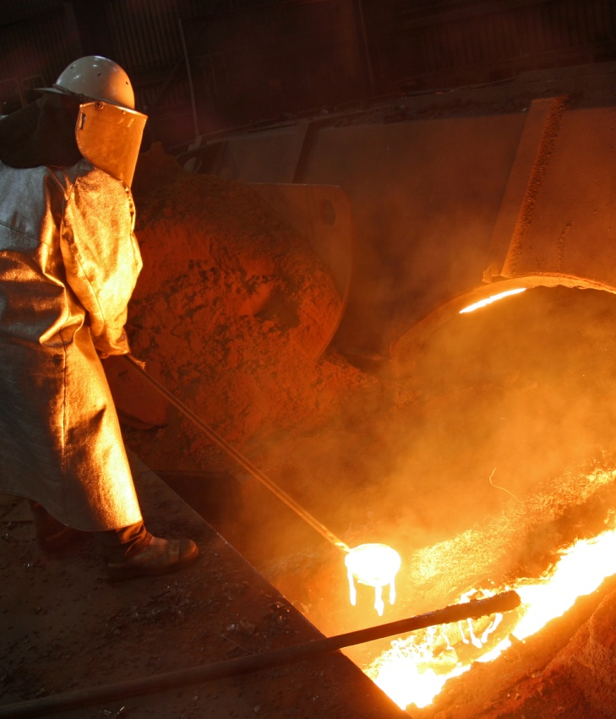
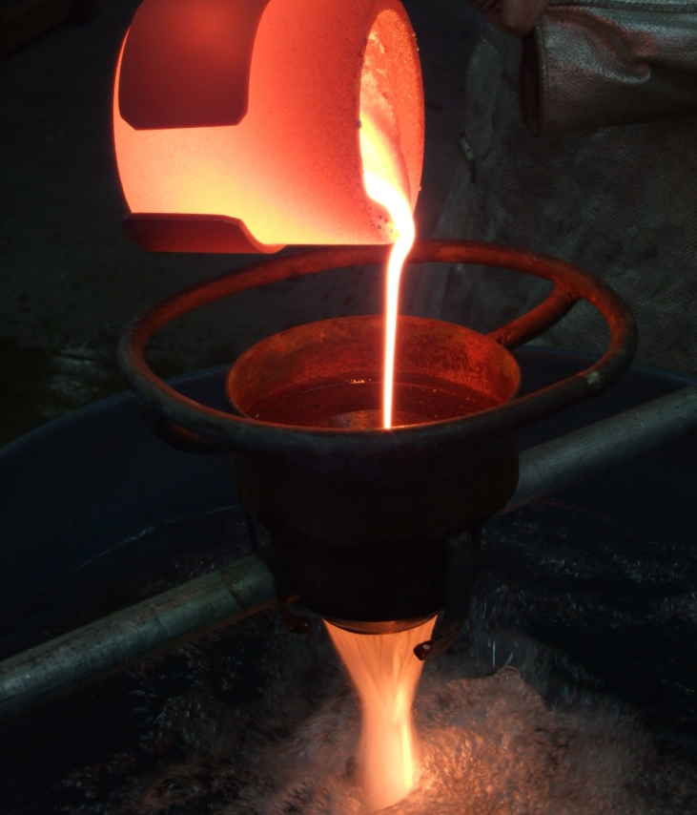
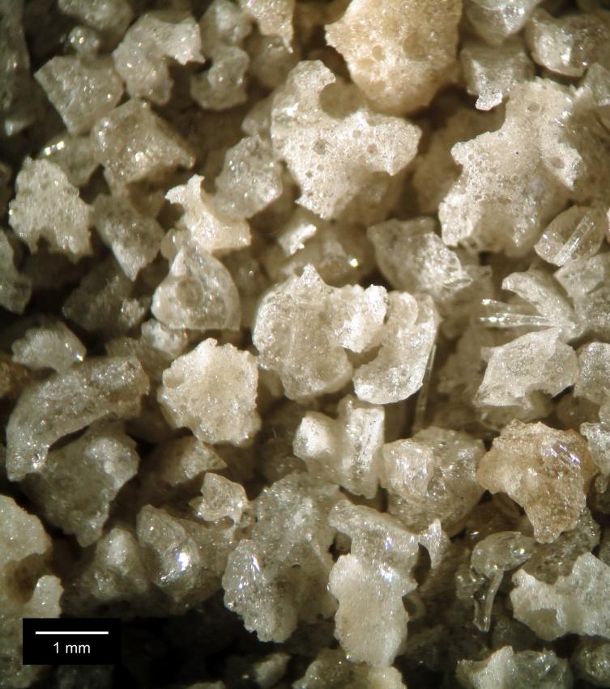
Basic ideas and questions

Slide 8
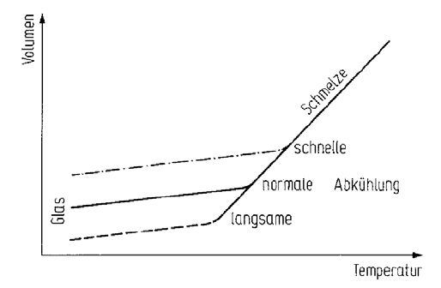
Basic ideas and questions
Theoretical background: Glass forming process
Enthalpy, volume
Enthalpy, volume
liquid
Undercooled liquid
liquid
fast
glass
glass
normal cooling
crystal
slow
T_{f}
T_{melt}
Temperature
Temperature
H. Scholze: Glas, 1977

Slide 9
Basic ideas and questions
Questions to be answered
    Are there significant differences in cooling history of GBS?
    Do they influence significantly GBS reactivity in slag cements and concretes?
    Are there differences between smaller (= faster cooled) and bigger (slower cooled) GBS particles?
    Can we influence it?

Slide 10
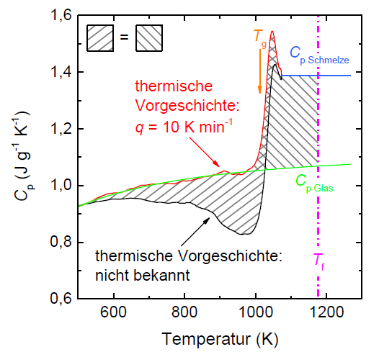
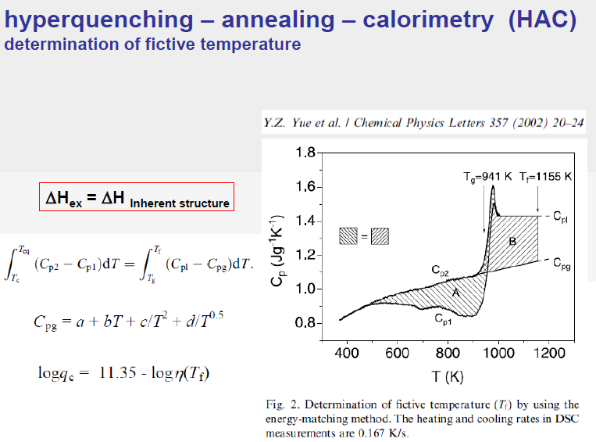
Basic ideas and questions: How to measure thermal history of GBS?
Combination of DSC- und viscosity analyses
(Hyperquenching-Annealing-Calorimetry - HAC)
C_{p, Liquid}
defined thermal history in lab:
q = 10 K/min
T_{g} = 1008.5 K = 735 °C
T_{f} = 1176.5 K = 903 °C
(= glass transformation temp.)
ΔH_{ex.} = 54.95 J/g
(= frozen energy)
!!
C_{p, Glass}
??
Heat capacity
unknown industrial thermal history: q = ??? K/min
Temperature (K)
GBS example No. 386
q = 4.1510⁵ K/s
(= industrial cooling rate)

Slide 11

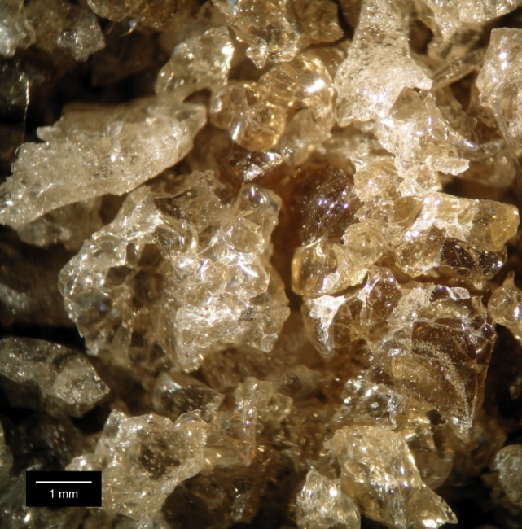
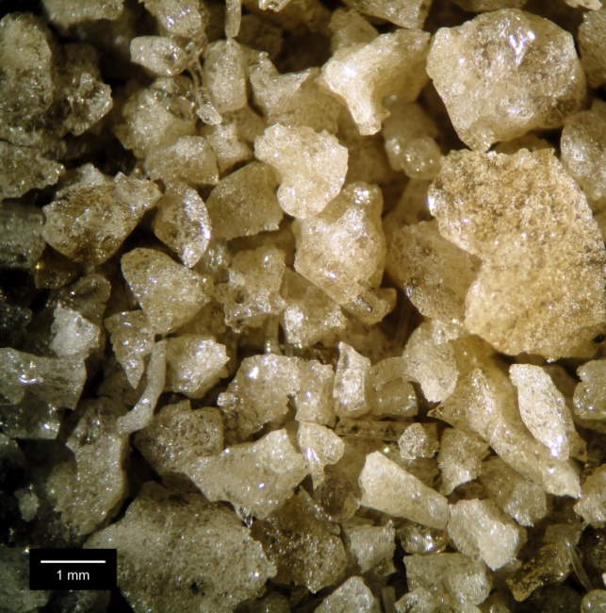
Basic ideas and questions
    Are there significant differences in cooling history of GBS?
 | (C+M)/S | Al₂O₃ | TiO₂ | MnO | T_{g} | T_{f} ("small") | T_{f} ("large")
GBS 11 | 1.36 | 11.8 | 0.43 | 0.16 | 743 | 817 | 780
GBS 13b | 1.18 | 12.4 | 0.61 | 1.48
GBS 14 | 1.44 | 13.7 | 1.16 | 0.25
    GBS 11
    GBS 13b
    GBS 14

Slide 12
Basic ideas and questions
    Are there significant differences in cooling history of GBS?
16 GBS | (C+M)/S | Al₂O₃ | TiO₂ | MnO | Glass | T_{g} | T_{f} ("small") | T_{f} ("large")
 | - | wt.-% |  |  | vol.-% | °C
Max. | 1.44 | 20.1 | 3.02 | 1.48 | 100 | 743 | 870 | 829
Min. | 1.13 | 6.8 | 0.27 | 0.12 | 95 | 731 | 811 | 774

Slide 13
    Do the differences in cooling history (= enthalpy content) influence significantly GBS reactivity in slag cements and concretes?
Properties of annealed GBS

Slide 14
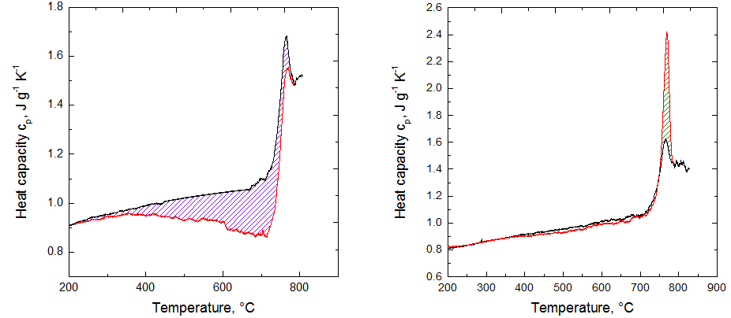
Properties of annealed GBS
Postulation: Annealing GBS below T_{g} (= stable glass content) should
decrease its energy content
Question: Do we find differences in technical properties?
Original
Annealed
2
2
1
1
GBS 14: 24 hours annealing at 0.9 x T_{g}

Slide 15
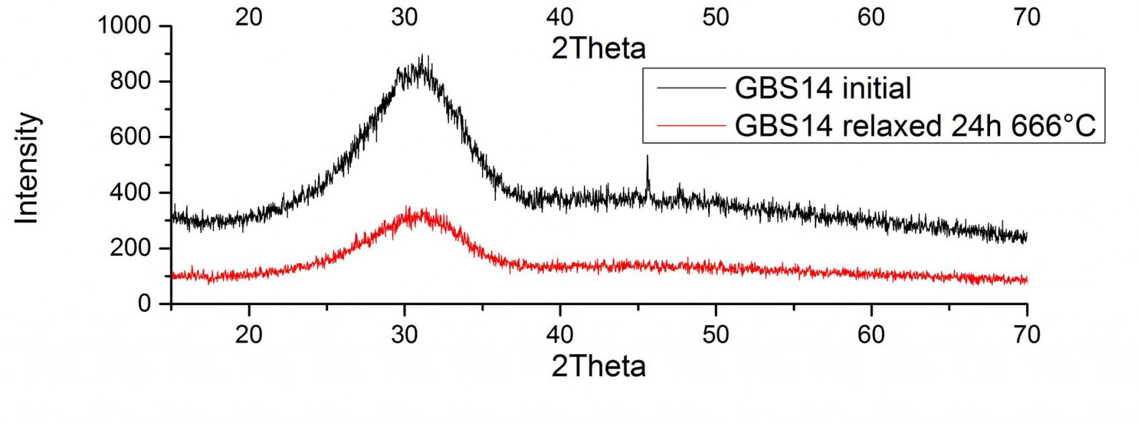
Properties of annealed GBS
Postulation: Annealing GBS below T_{g} (= stable glass content) should
decrease its energy content
Question: Do we find differences in technical properties?
GBS 14: 24 hours annealing at 0.9 x T_{g}

Slide 16
Properties of annealed GBS
Reactivity (cementitious tests): Chemical composition
 | (C+M)/S | Al₂O₃ | TiO₂ | MnO | Glass
 | - | wt.-% |  |  | vol.-%
GBS 11 | 1.36 | 11.8 | 0.43 | 0.16 | 100
GBS 13b | 1.18 | 12.4 | 0.61 | 1.48 | 99
GBS 14 | 1.44 | 13.7 | 1.16 | 0.25 | 98
    GBS 11
    GBS 13b
    GBS 14

Slide 17
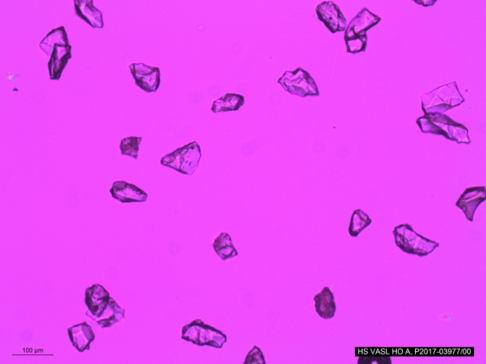
Properties of annealed GBS
Reactivity (cementitious tests): Again 24 hours annealing at 0.9 x T_{g}
2,895 g/cm³
606 HV_{0.1}
2,910 g/cm³
599 HV_{0.1}
GBS 13b original
GBS 14 original
2,943 g/cm³
648 HV_{0.1}
2,958 g/cm³
633 HV_{0.1}
GBS 13b annealed
GBS 14 annealed

Slide 18
Properties of annealed GBS
Reactivity (cementitious tests): Grinding

Slide 19
Properties of annealed GBS
Reactivity (cementitious tests): Heat of hydration
(GBS/CL = 75/25; w/c = 0.5)

Slide 20
Properties of annealed GBS
Reactivity (cementitious tests): EN 196-1 mortar strength
(GBS/CL = 75/25; w/c = 0.5)

Slide 21
    Do the differences in cooling history (= enthalpy content) influence significantly GBS reactivity in slag cements and concretes?
Properties of GBS fractions

Slide 22
Properties of GBS fractions
Postulation: Smaller GBS particles should have a higher energy content
Question: Do we find differences in technical properties?
 | < 0.5 mm | > 1.0 mm | > 2.0 mm | Average
 | wt.-%
GBS 11 | 26 | 34 | 5 | 100
GBS 13b | 13 | 60 | 26 | 100
GBS 11 | < 0.5 mm | > 1.0 mm | > 2.0 mm | Average
d' | 16 | 17 | 17 | 15 | µm
n | 1.046 | 1.058 | 1.068 | 0.999 | -
Blaine | 4290 | 4160 | 4220 | 4190 | cm²/g
GBS 13b | < 0.5 mm | > 1.0 mm | > 2.0 mm | Average
d' | 16 | 16 | 17 | 15 | µm
n | 1.121 | 1.053 | 1.063 | 1.003 | -
Blaine | 4350 | 4320 | 4290 | 4200 | cm²/g

Slide 23
Properties of GBS fractions
Reactivity (cementitious tests): Heat of hydration
(GBS/CL = 75/25; w/c = 0.5)

Slide 24
Properties of GBS fractions
Reactivity (cementitious tests): EN 196-1 mortar strength
(GBS/CL = 75/25; w/c = 0.5)
> 2.0 mm: 5 wt.-%
> 2.0 mm: 26 wt.-%

Slide 25
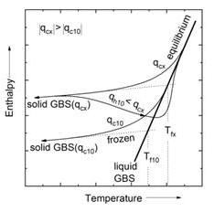
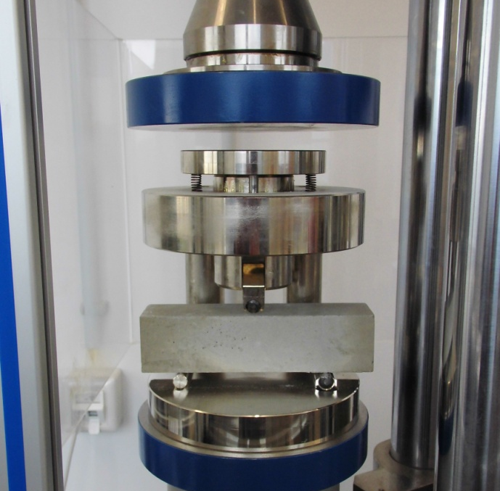
Conclusions

Slide 26
Conclusions
    Industrial GBS have different cooling histories and different enthalpy contents (➔ T_{f})
    For the first time it was shown quantitatively that different enthalpy contents result in different reactivities (other parameters are kept constant)
    The reactivity contribution is significant and explains the failure of simple correlations based only on chemical composition and glass content
    Smaller and larger GBS particles have different cooling histories and enthalpy contents, too
    Smaller GBS particles have a higher reactivity compared to coarser particles, in particular after 2 and 7 days
    The influence of T_{f} seems to be higher compared to grain size effect
    The results are of high importance also for dry granulation processes having much more lower cooling rates compared to water granulation
    Industrial granulation facilities should not aim only to handle high slag volumes at so high temperatures as possible and to achieve maximum glass contents but also to produce finer particles with maximised cooling rates
Thank you for your attention!

Slide 27


Acknowledgements
The research project IGF 19416 of Steel Institute VDEh is supported via AiF by the German Federal Ministry for Economic Affairs and Energy based on a decision of German Bundestag.
The financial help is gratefully acknowledged.

